Slide 1
Leadership University
Welcome to Biblical Studies

Slide 2
Biblical Studies The Book of EXODUS
It is over 400 years later and the once-favored Hebrews are now _______
SLAVES

Slide 3
Biblical Studies The Book of EXODUS
THE CENTRAL MESSAGE
The overall theme of Exodus is redemption

Slide 4
Biblical Studies The Book of EXODUS
The Exodus shows the power of God as a
___________
DELIVERER

Slide 5
Biblical Studies The Book of EXODUS
God raises up a man named Moses to be the deliverer of His people

Slide 6
Biblical Studies The Book of EXODUS
The Passover lamb is a type of Christ

Slide 7
Biblical Studies The Book of EXODUS
Just as God redeemed His people by _______at the Passover
BLOOD

Slide 8
Biblical Studies The Book of EXODUS
The whole world sees the _______ and presence of God at the crossing of the Red Sea
POWER

Slide 9
Biblical Studies The Book of EXODUS
The Law shows the character of God as a standard

Slide 10
Biblical Studies The Book of EXODUS
The Tabernacle shows the glory of God as ____________
PROVIDER

Slide 11
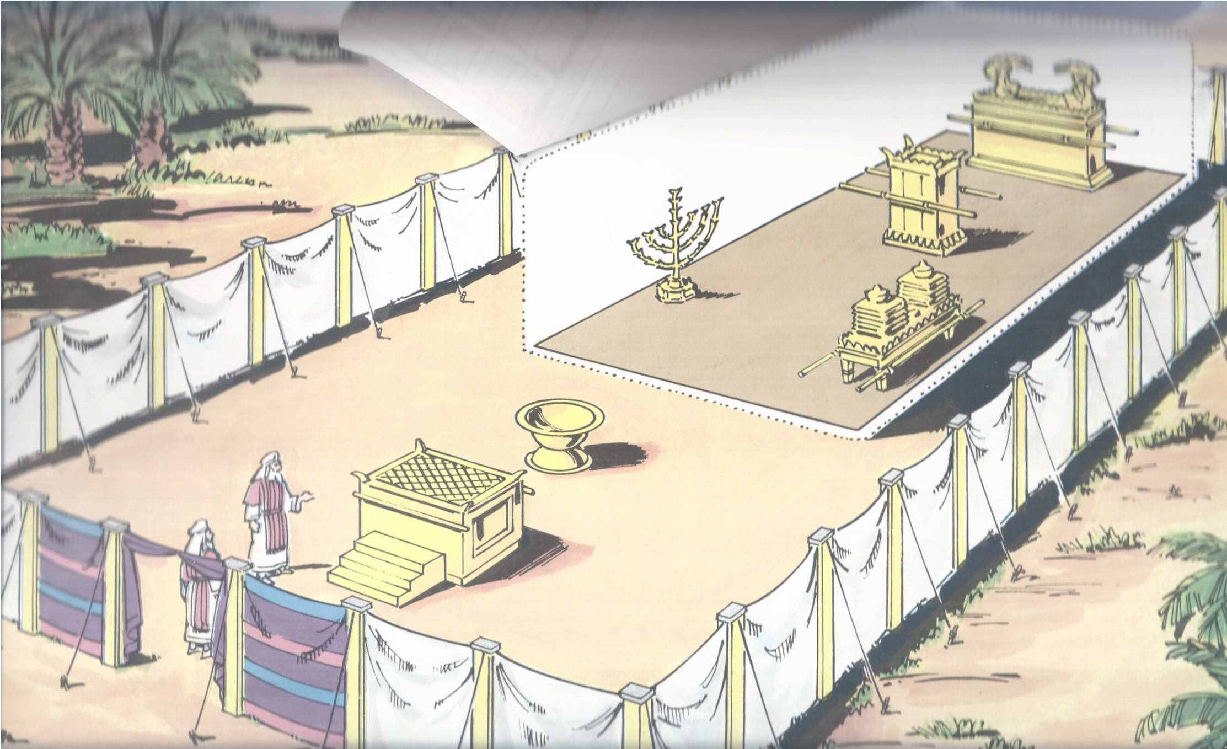
Biblical Studies The Book of EXODUS
God Bless You

Slide 12
Biblical Studies The Book of EXODUS
Everything in the tabernacle was placed there by God’s instruction and is filled with symbolism

Slide 13
Biblical Studies The Book of EXODUS
The bronze alter is a symbol of the _______ where Jesus (The Perfect Sacrifice) was offered up and sacrificed for our sins
CROSS

Slide 14
Biblical Studies The Book of EXODUS
The basin was for cleansing. Washing was a symbol that man had to be pure before approaching God

Slide 15
Biblical Studies The Book of EXODUS
The golden lampstand was the only source of light in the Holy place

Slide 16
Biblical Studies The Book of EXODUS
The lamp-stand speaks of Jesus. The oil in the lampstand speaks of the Holy Spirit

Slide 17
Biblical Studies The Book of EXODUS
The table of showbread with 12 loaves of bread represented the 12 tribes of Israel

Slide 18
Biblical Studies The Book of EXODUS
Bread is the symbol of life itself. A picture of God’s ___________ both physically and spiritually
PROVISION

Slide 19
Biblical Studies The Book of EXODUS
The incense represented prayer. Because of Jesus we can go directly to God with our prayers

Slide 20
Biblical Studies The Book of EXODUS
The “Holy of Holies” is where the presence of God Himself was

Slide 21
Biblical Studies The Book of EXODUS
This was a temporary solution to the separation of God and man because of sin

Slide 22
Biblical Studies The Book of EXODUS
At the time of Jesus death on the cross, the veil was torn representing a ___________ solution to bring people back to God!
PERMANENT

Slide 23
Biblical Studies The Book of EXODUS
For God’s will was for us to be made holy by the sacrifice of the body of Jesus Christ, once for all time. NLT
Hebrews 10:10

Slide 24
Biblical Studies The Book of EXODUS
God Bless You

